Slide 1
PRCO204 Group Presentation
Flight Application

Slide 2
Product Goals
A flight application so customers can search for, book, pay for and cancel flights
Administrators can create and remove flights; they can also view the audit log, send secure messages to customers and run statistics for business purposes

Slide 3
Backlog
https://github.com/Plymouth-University/prco204-flight-crew/projects/2

Slide 4
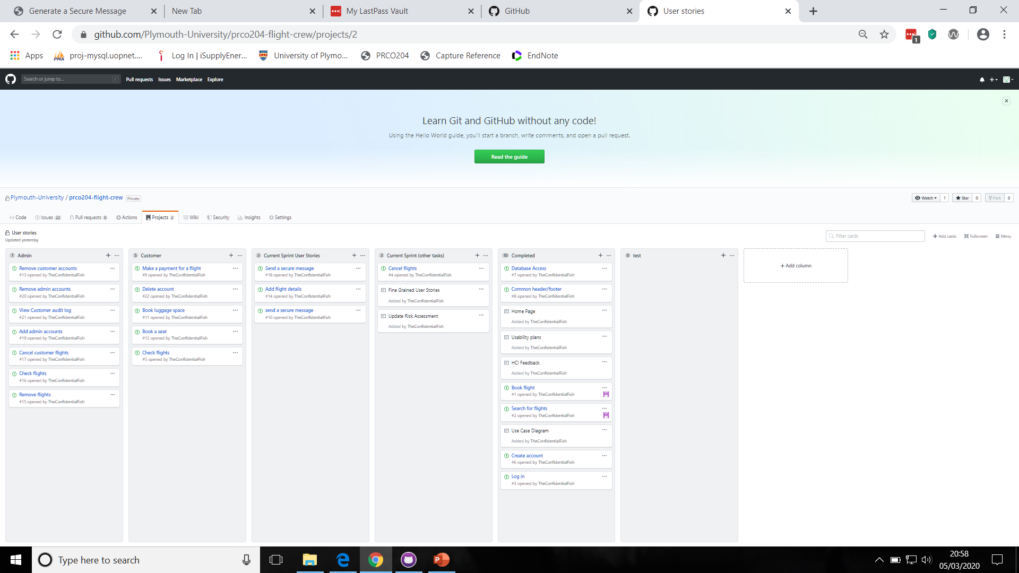
Backlog

Slide 5
Sprint Planning
Current Sprint Documents:
Sprint 1 – implement stage 1 of Storymap
Sprint 2 – implement stage 2
Planned:
Sprint 3 – implement stage 3 and 4
Sprint 4 – review, refine, write reports

Slide 6
Story Map
User Activities |  | Flight Management |  | Account Management |  | Admin
User Tasks |  | Search/Book/Cancel/Pay for a flight |  | Create/Delete Account |  | Add/Remove/Check Flight | View audit logs/send a secure message
User Stories | Stage 1 | Customer logs in, searches for an then books a flight |  | Customer Creates an Account
 | Stage 2 | Customer pays for a flight | Customer cancels a flight |  |  | Administrator add/removes a flight | Administrator sends a secure message to a customer
 | Stage 3 |  |  |  | Customer deletes account |  | Administrator looks at stats
 | Stage 4 |  |  |  |  |  | Administrator looks at security logs
 | Stage 5
User activities
User tasks
User stories
Flight management
Account management
Admin
View audit logs / send a secure message
Search / Book / Cancel / Pay for a flight
Create / Delete account
Add/remove/check flights
Customer logs in, searches for an then books a flight
Customer creates an account
Stage 1
Administrator adds/removes a flight
Administrator sends a secure message to a customer
Stage 2
Customer pays for a flight
Customer cancels a flight
Stage 3
Customer deletes account
Administrator looks at stats
Administrator looks at security logs
Stage 4

Slide 7
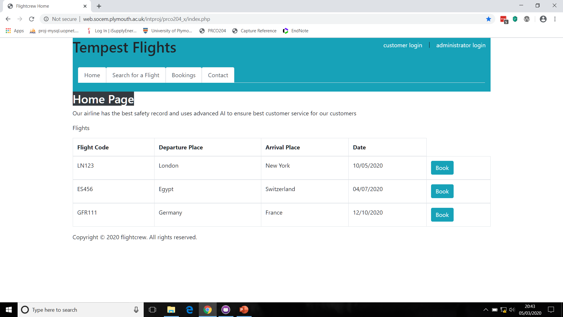
Product Demo - Home Page

Slide 8
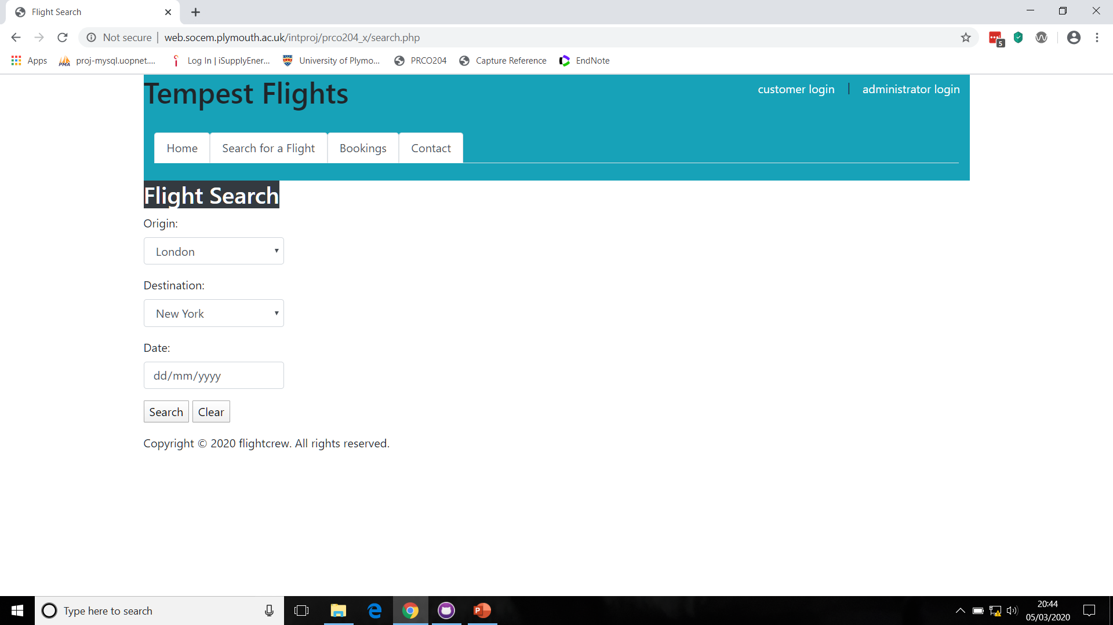
Product Demo –Flight Search

Slide 9

Product Demo – Customer Login

Slide 10
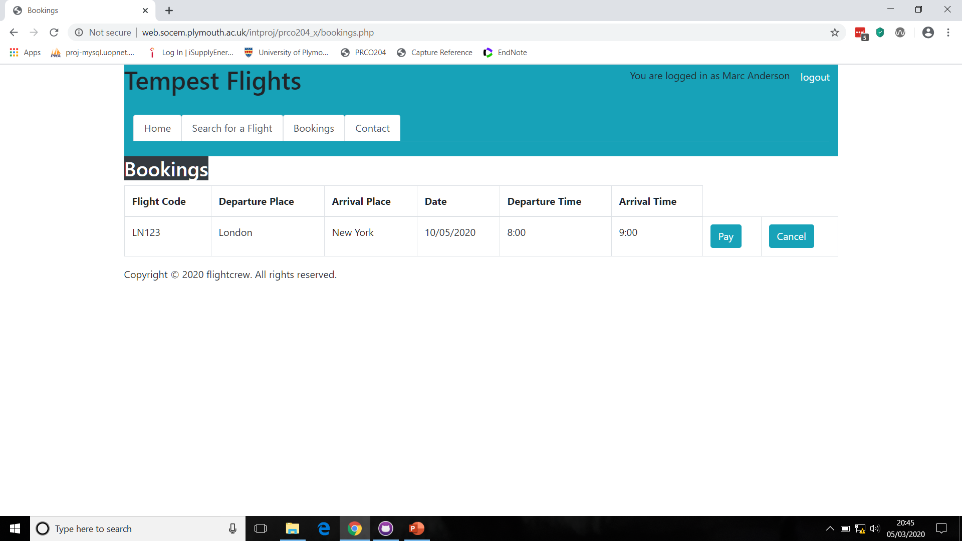
Product Demo - Bookings

Slide 11
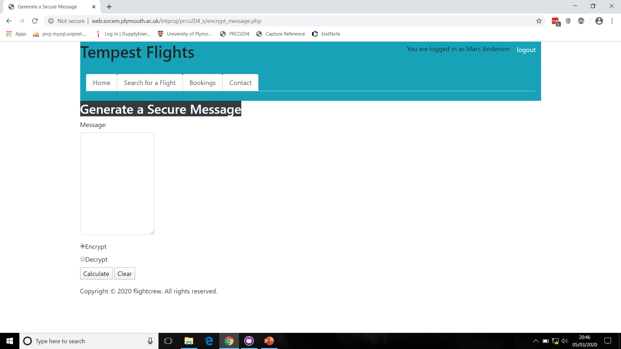
Product Demo – Generate a Secure Message

Slide 12
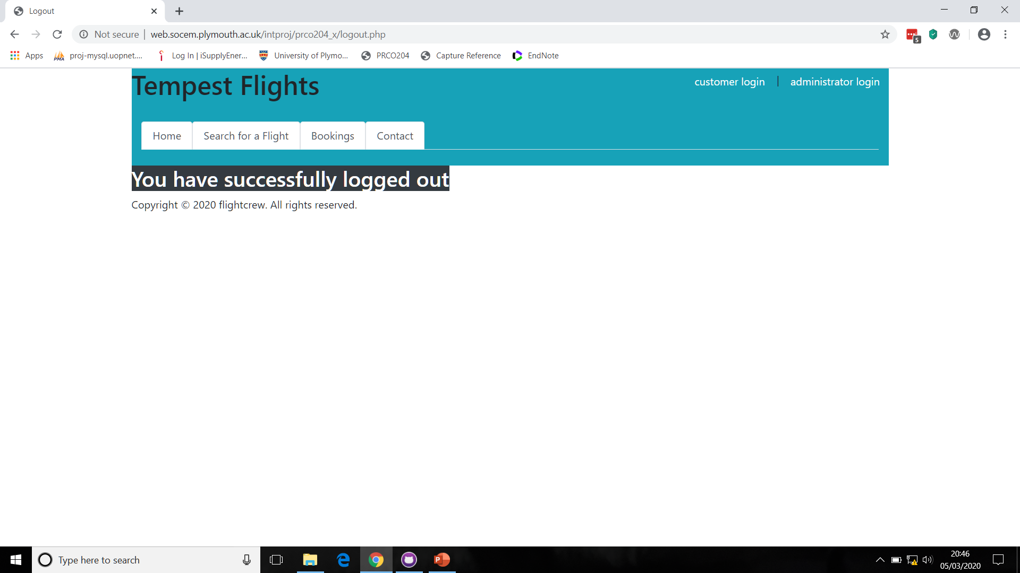
Product Demo – Customer Logout

Slide 13
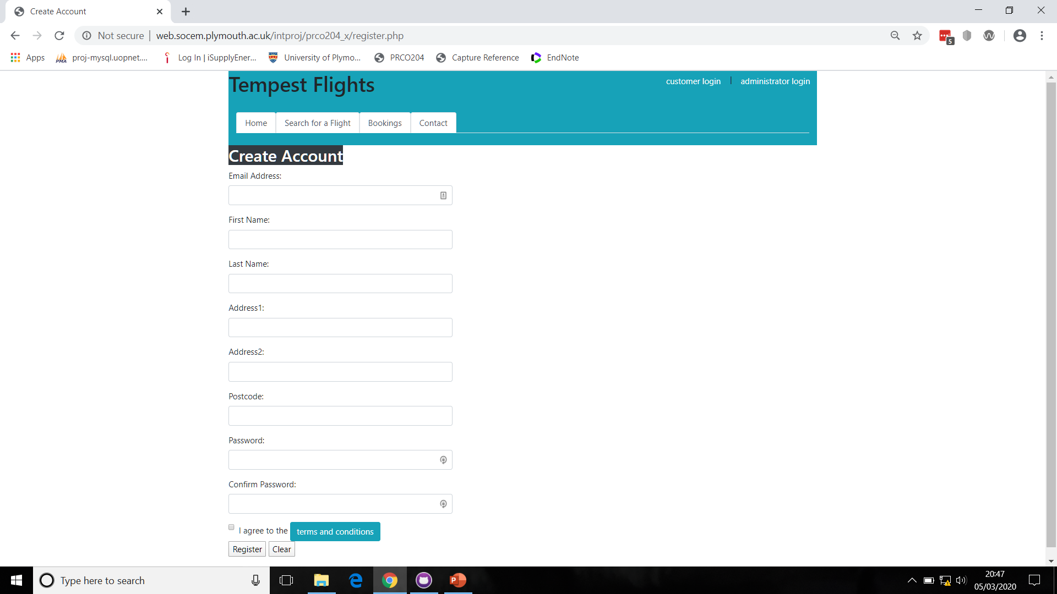
Product Demo – Customer Create Account

Slide 14
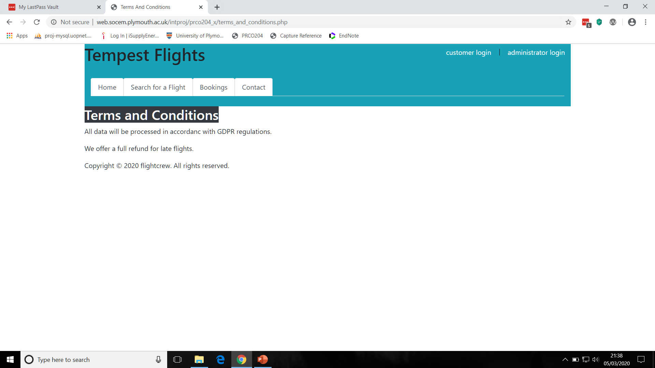
Product Demo – Terms and Conditions

Slide 15
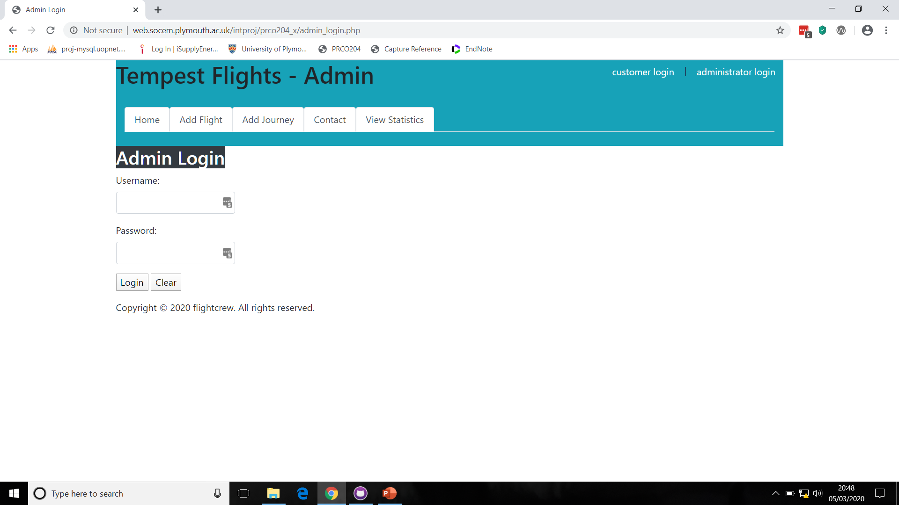
Product Demo – Admin Login

Slide 16
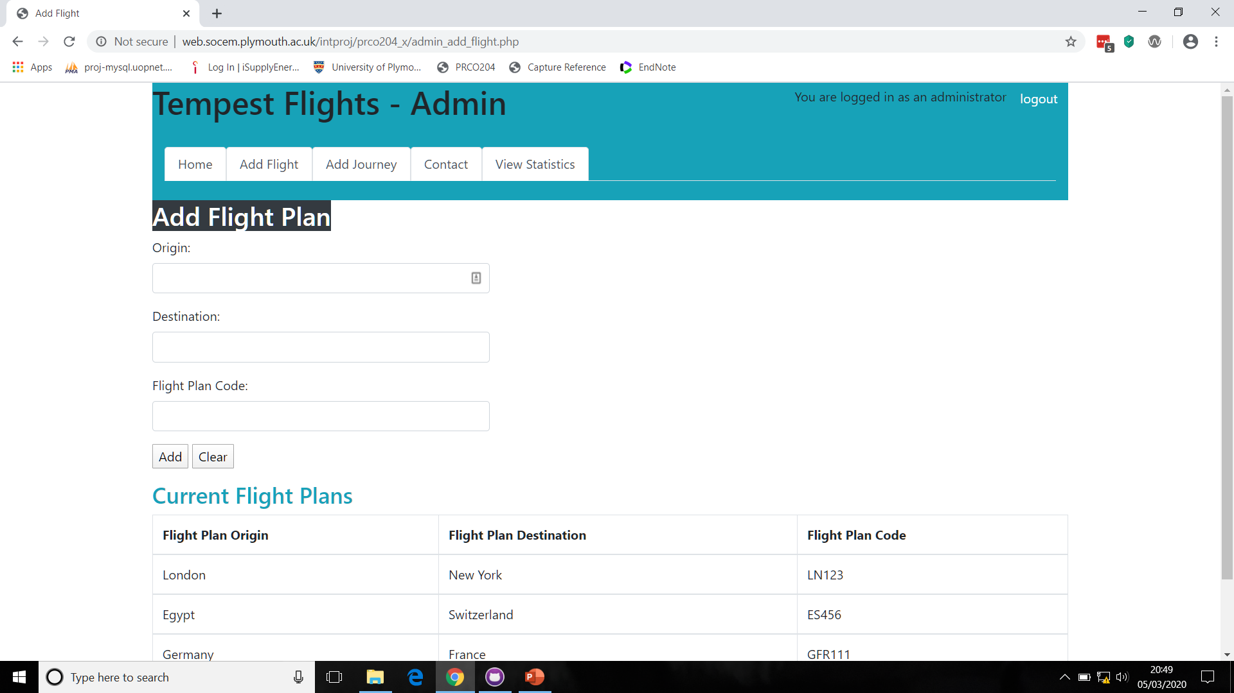
Product Demo – Add Flight Plan

Slide 17
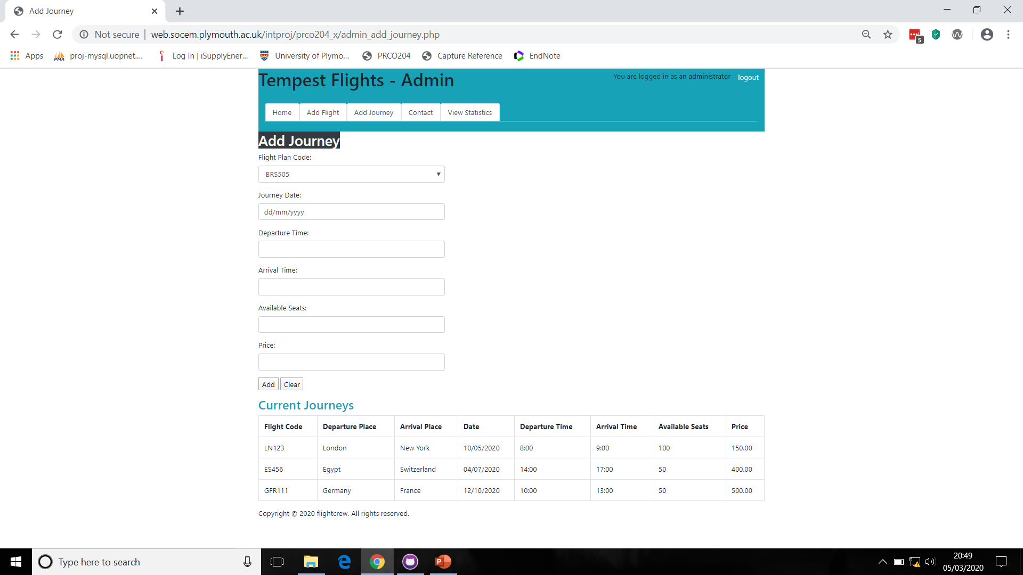
Product Demo – Add Journey

Slide 18
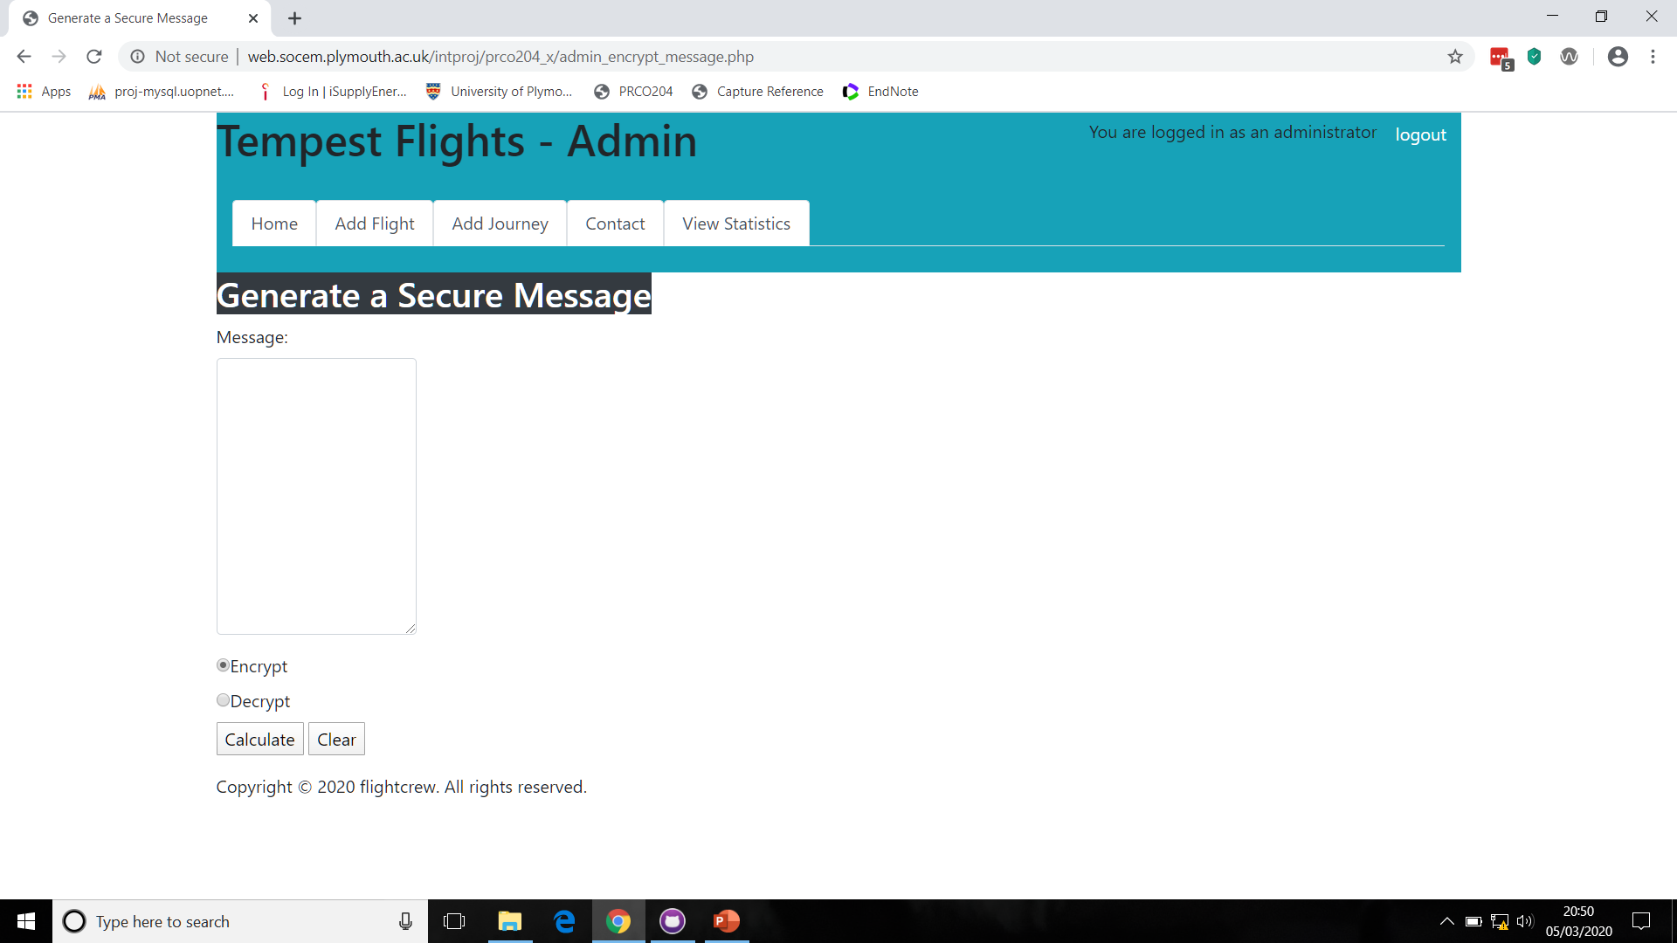
Product Demo – Generate Secure Message

Slide 19
HCI Initial Review
Dates changed from yyyy-mm-dd to dd/mm/yyyy as it was felt this was more customer friendly
A problem with results being displayed to the left of the screen was corrected so it displayed in the correct frame
A problem with the secure message page was corrected, as it did not deal with spaces and other characters correctly, also it was felt better to call it “contact” page as customers are more used to this
After login in the header bar it was changed to read customer name rather than customer ID as logged in as this is more meaningful to the customer
The colour scheme was changed to light blue for the header as colour blindness affects the ability to see the colour green as it was previously
A more thorough HCI review will be done later

Slide 20
Testing, OOP and User Case Scenario's
A xml acceptance test file has been created for testing, at present it has to be run manually unless a way can be found to automate it
Unit testing has been more challenging as the functions and code are integrated with database calls and its not clear how they could be isolated
At present there has not been a great need for OOP design, but this could be considered later, such as making data classes, however according to agile philosophy its best only to implement where code becomes inflexible or a need becomes apparent
Use case scenario's have been developed and are found in detail on the GitHub repo

Slide 21
Critique of progress so far
Good progress has been made to implement planned functionality, the project is on course, stage 1 functionality is complete, stage 2 is progressing well
More work will be done on HCI testing, although there has been an initial review
We have adapted our coding approach to try to finish individually assigned elements in the first week of the sprint, and leave integration and paired programming for the second week

Slide 22
Risk Assessment – Project Scope
Risk | Current Risk Chance | Risk Effect | Mitigation
not enough time to complete the project | Medium-Low | Low Quality End Product | stick to MVP, only add extra features if time allows, allow extra time for unseen problems
team members unwell or personal crisis | Medium-High | Delay | keep in touch with unwell/absent members via boards and allocate work if appropriate Regular (near daily) Sprint Communication
disagreement on the way forward | Medium-Low | Low Quality End Product/Delay/ Inter personal conflicts | in the case of a disagreement, try reach compromise, otherwise vote or refer to module leader
over or under estimating work that can be achieved in a sprint | Medium | Delay/Unbalanced workload (being near idle one week and overly busy the next) | allocate points for each functional task, each person can say how many points that can achieve in 2 weeks, then can use that to estimate right amount of work for future sprints Regular (near daily) Sprint Communication
project does not work, lots of bugs | Medium-Low | Low Quality End Product | create unit tests at the same time or before creating code
spending too much time on one task | Medium-Low | Low Quality End Product/Delay | break down tasks into smaller units
client unhappy with the result | Low | Low Quality End Product | implement acceptance testing, perhaps using XML for a list of commands to test
team member struggles with coding | Medium | Low Quality End Product/Delay | pair programming to help team members struggling with coding and to reduce bugs Each part of the system orchestrated by those with greatest area expertise (I.E Database development directed by person with confidence in databases)

Slide 23
Any Questions?

